Slide 1
Operations on 2D Arrays
ELEC1006: ENGINEERING COMPUTING

Slide 2

2D Array Initialisation
Given the following definitions:
const int NUM_STUDENTS = 3;
const int NUM_SCORES = 5;
double total = 0.0; // Accumulator
double average; // To hold average scores
double scores[NUM_STUDENTS][NUM_SCORES] =
{{88, 97, 79, 86, 94},
{86, 91, 78, 79, 84},
{82, 73, 77, 82, 89}};
PAGE 2

Slide 3

Example 1: Summing all Elements in a 2D Array
// Sum the array elements.
for (int row = 0; row < NUM_STUDENTS; row++)
{
for (int col = 0; col < NUM_SCORES; col++)
total += scores[row][col];
}
// Display the sum.
cout << "The total score for all students is " << total << endl;
PAGE 3

Slide 4
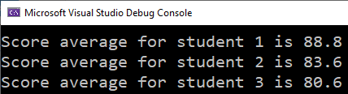
Example 2: Summing the columns of the 2D Array
// Get each student's average score.
for (int row = 0; row < NUM_STUDENTS; row++)
{
// Set the accumulator.
total = 0;
// Sum a row.
for (int col = 0; col < NUM_SCORES; col++)
total += scores[row][col];
// Get the average
average = total / NUM_SCORES;
// Display the average.
cout << "Score average for student "
<< (row + 1) << " is " << average <<endl;
}
PAGE 4

Slide 5
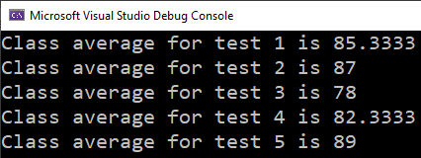
Example 3: Summing the rows of the 2D Array
// Get the class average for each score.
for (int col = 0; col < NUM_SCORES; col++)
{
// Reset the accumulator.
total = 0;
// Sum a column
for (int row = 0; row < NUM_STUDENTS; row++)
total += scores[row][col];
// Get the average
average = total / NUM_STUDENTS;
// Display the class average.
cout << "Class average for test " << (col + 1)
<< " is " << average << endl;
}
PAGE 5

Slide 6
More info
[1] cplusplus.com: Arrays
https://www.cplusplus.com/doc/tutorial/arrays/
[2] leanrcpp.com: 6.1 – Arrays (Part I) https://www.learncpp.com/cpp-tutorial/61-arrays-part-i/
[3] learncpp.com: 6.2 – Arrays (Part II)
https://www.learncpp.com/cpp-tutorial/62-arrays-part- ii/
[4] learncpp.com: 6.3 – Arrays and loops
https://www.learncpp.com/cpp-tutorial/63-arrays-and- loops/
PAGE 6

